Slide 1

The Landscape Expansion Index (LEI)
7 April 2017

Slide 2
Content
1
Introduction
2
Usage
3
Case study

Slide 3
Content
1
Introduction
2
Usage
3
Case study

Slide 4
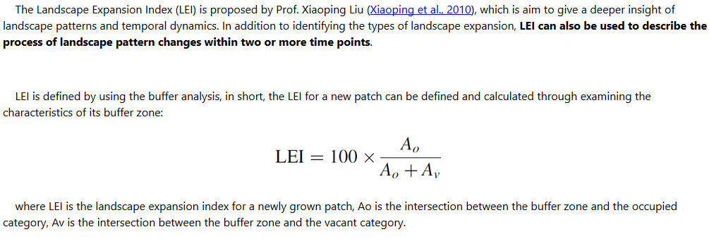
The Landscape Expansion Index (LEI)
Reference
Xiaoping Liu, Xia Li, Yimin Chen et al. 2010. A new landscape index for quantifying urban expansion using multi-temporal remotely sensed data, Landscape Ecology, 25:671–682

Slide 5
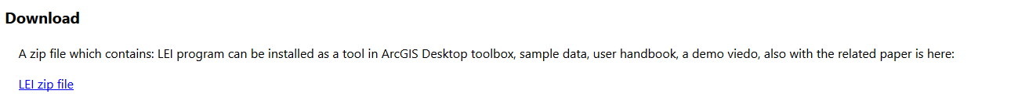
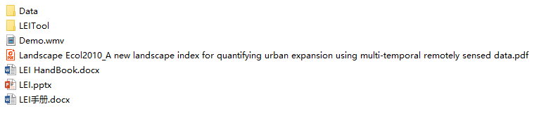
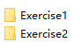
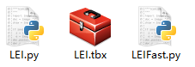
Download LEI
http://www.geosimulation.cn/LEI.html
What’s in LEI folder?

Slide 6
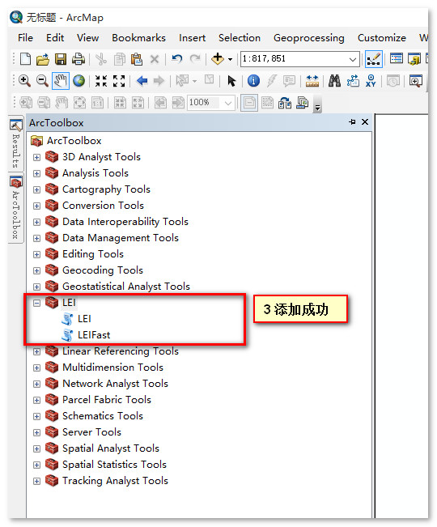
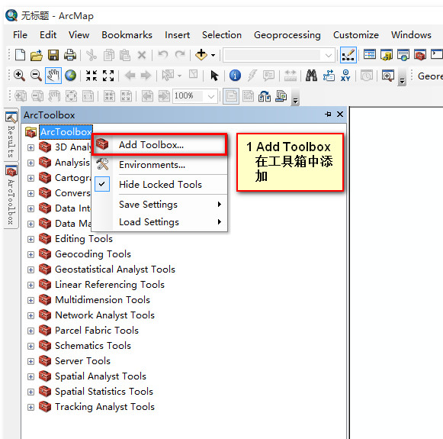
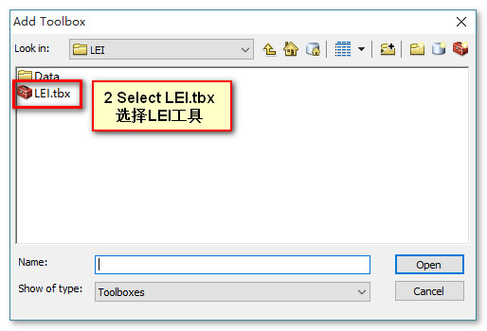
Add LEI tools to ArcToolbox

Slide 7
Content
1
Introduction
2
Usage
3
Case study

Slide 8
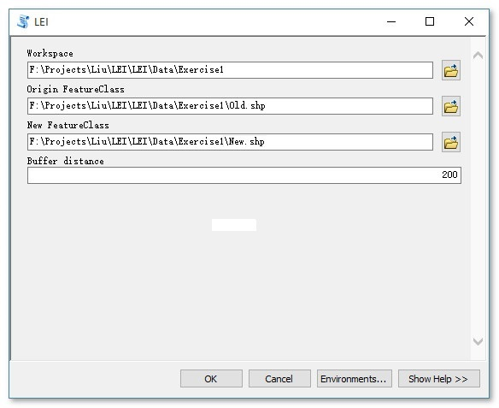
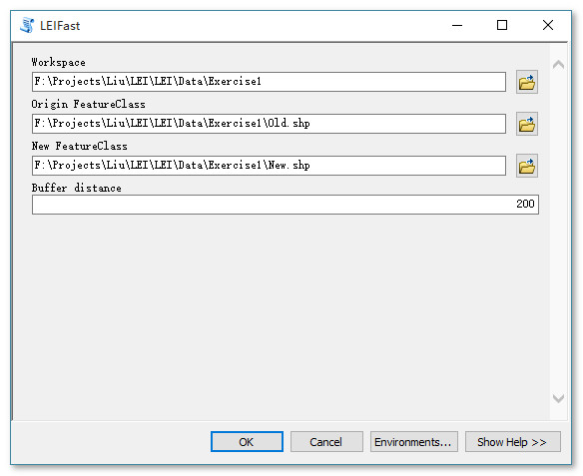
LEI Panel
Parameters:
Workspace——文件夹或GDB
Origin FeatureClass——初始数据
New FeatureClass——新增的数据
Buffer distance——缓冲区距离
Support GDB and Shapefile

Slide 9
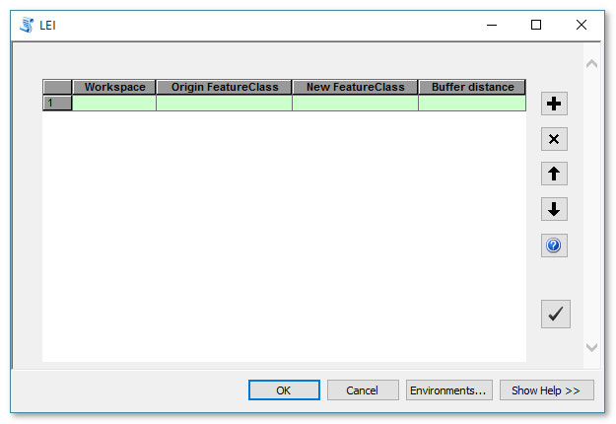
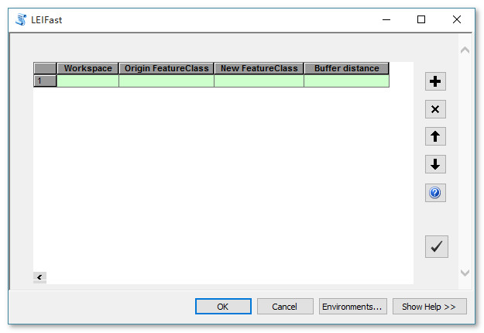
LEI Panel for Bantch
What’s the difference between LEI and LEIFast?
LEIFast is the old version to calculate the LEI and it run faster than LEI. In some case which we didn’t find the reason yet, LEIFast may get error and set the error LEI value 999.
Hence, we developed a new LEI.py which is a more strong one. In LEI.py, we can also get a LEITemple layer which is the difference between the new polygon and its buffer region.

Slide 10
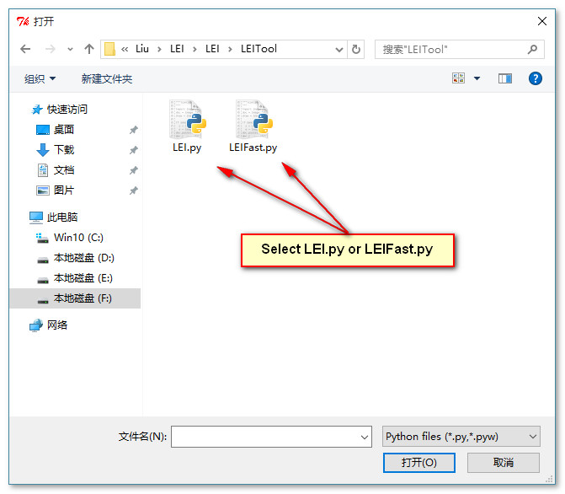
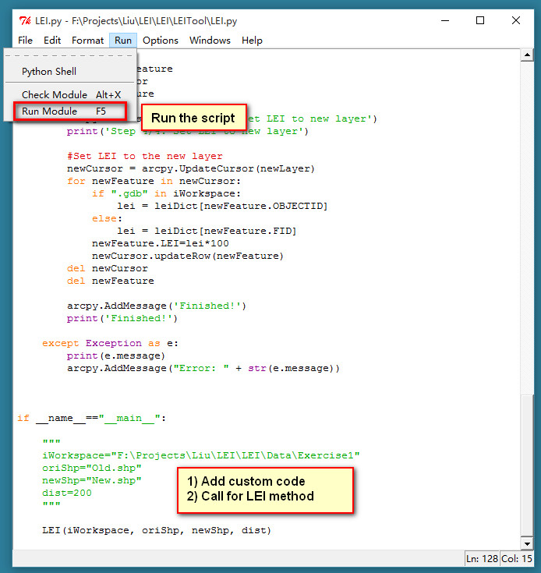
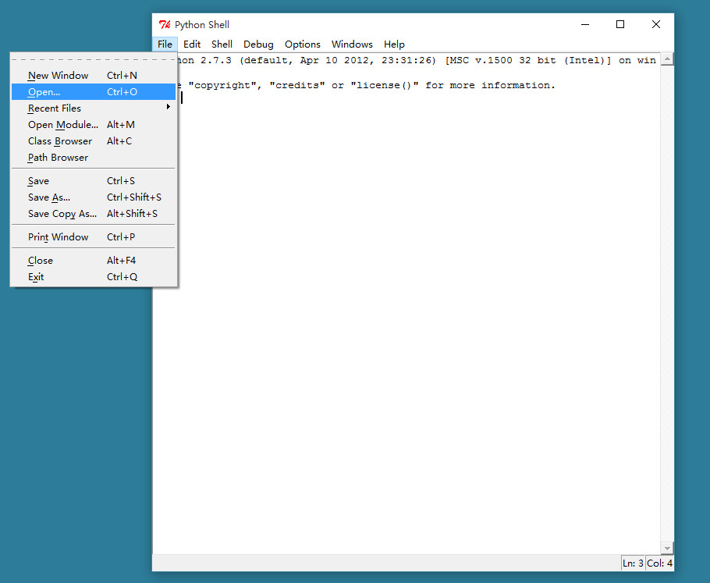
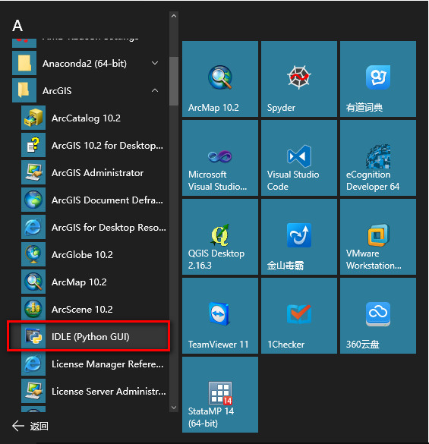
LEI for Python

Slide 11
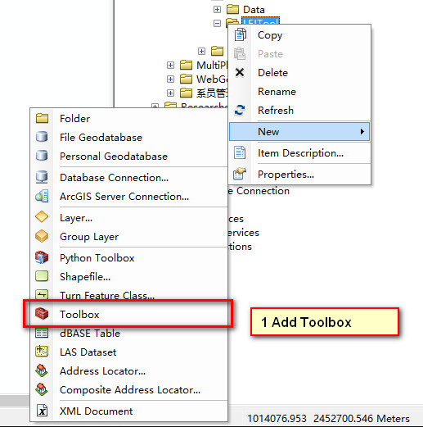
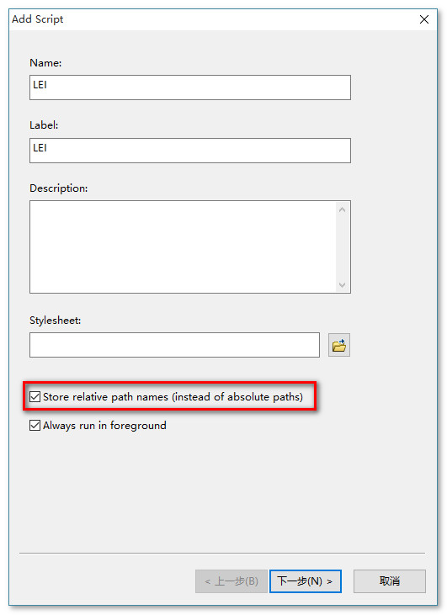
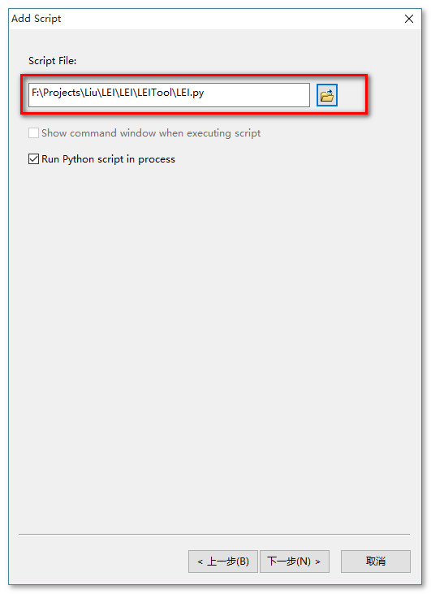
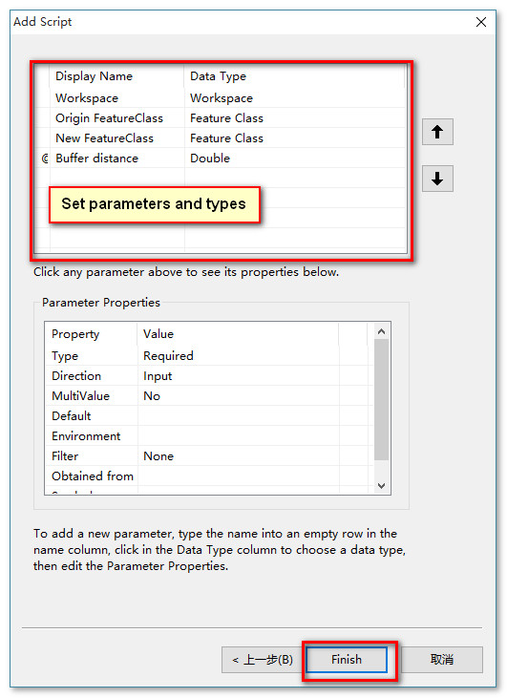
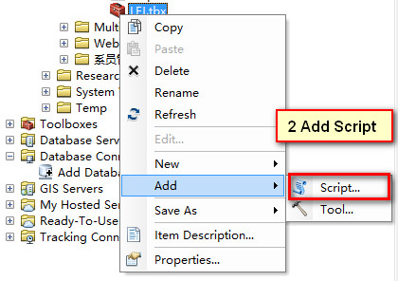
Create LEI tools for other ArcGIS version

Slide 12
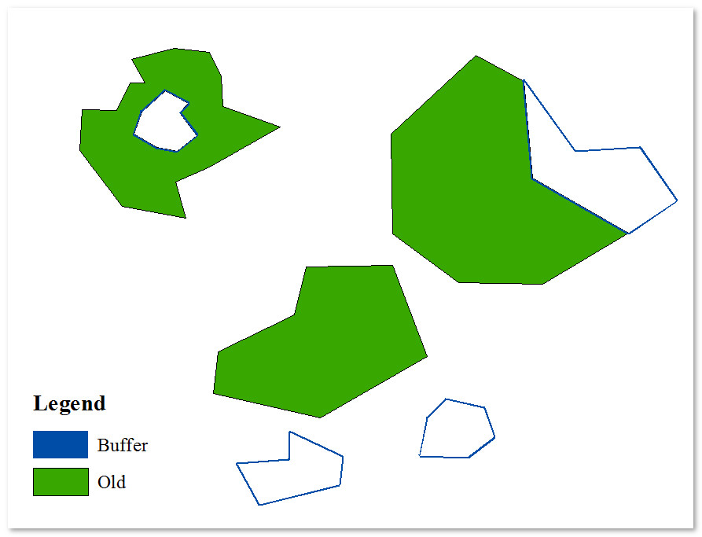
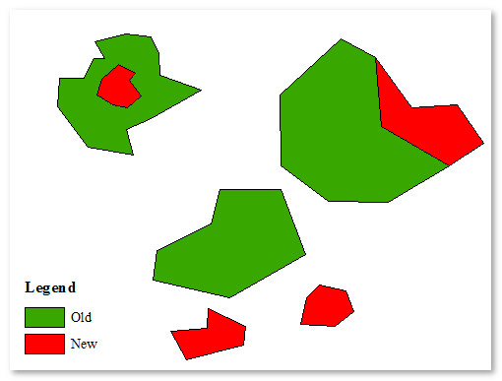
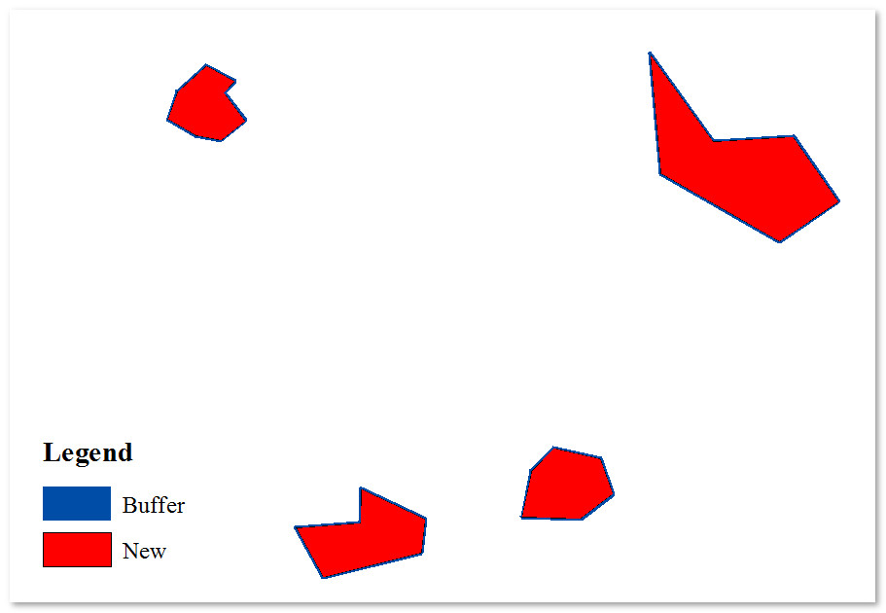
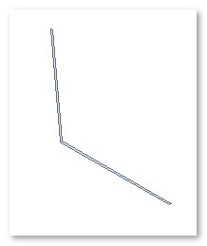
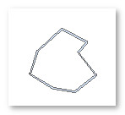
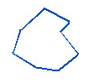
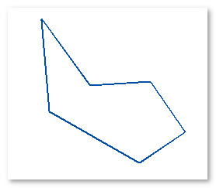
Test for LEI
1b
1b
1a
2b
1a
2a
2b
×100 = 100
2c
×100 = 42.8436
3a
3c
4b
4b
3b
3b
~LEI\Data\Exercise1\Old.shp ~LEI\Data\Exercise1\LEITemple.shp
~LEI\Data\Exercise1\New.shp ~LEI\Data\Exercise1\LEI_test.shp

Slide 13
Content
1
Introduction
2
Usage
3
Case study

Slide 14
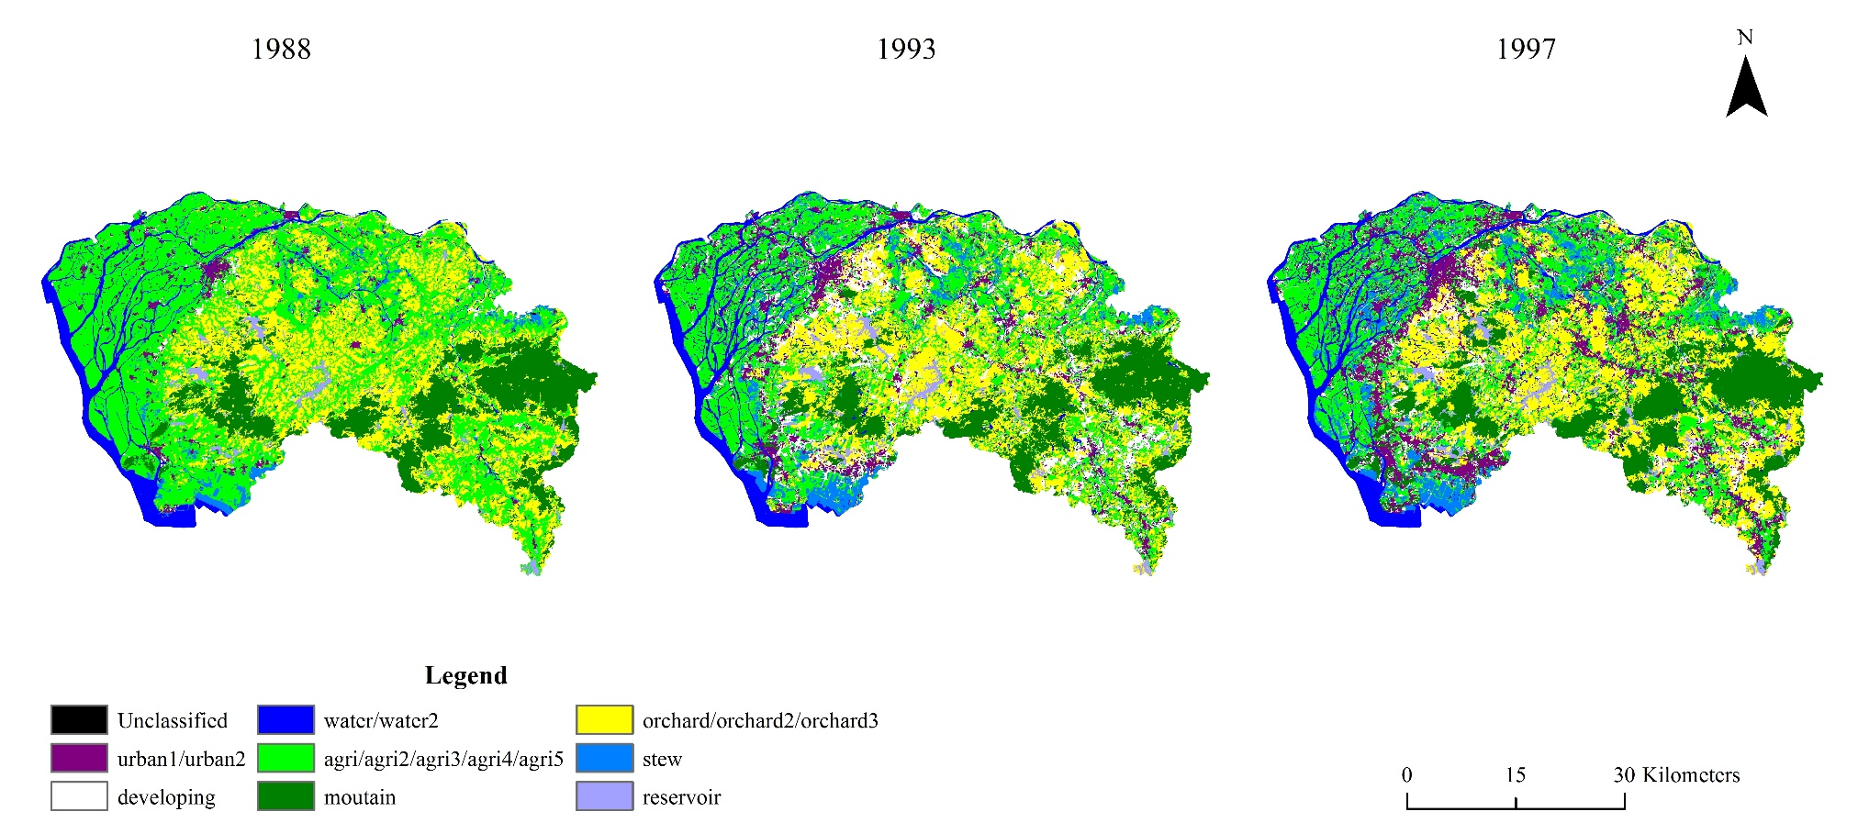
Case study
Data——Landuse data of DongGuan in 1988, 1993 and 1997
~LEI\Data\Exercise2\Dongguan\1988.img
~LEI\Data\Exercise2\Dongguan\1993.img
~LEI\Data\Exercise2\Dongguan\1997.img

Slide 15
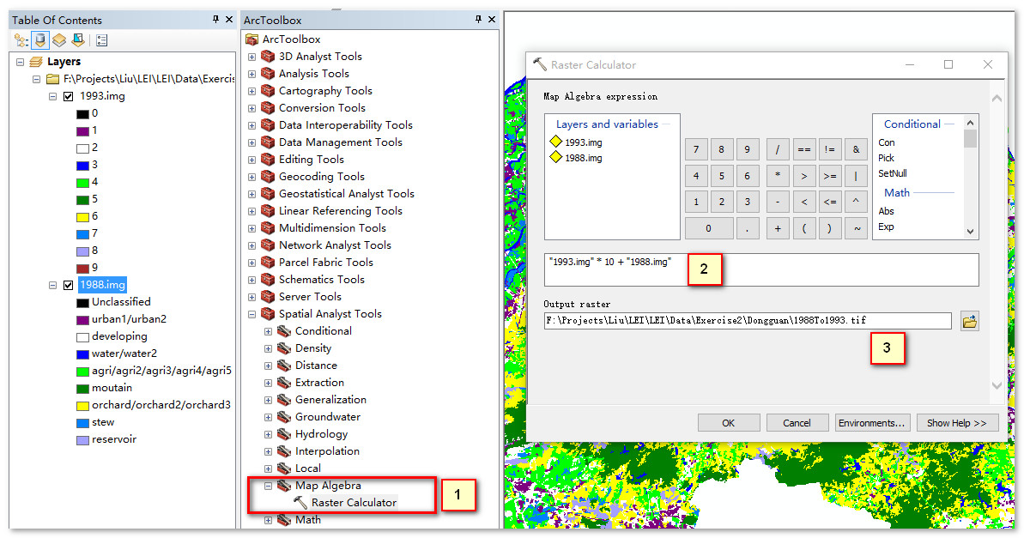
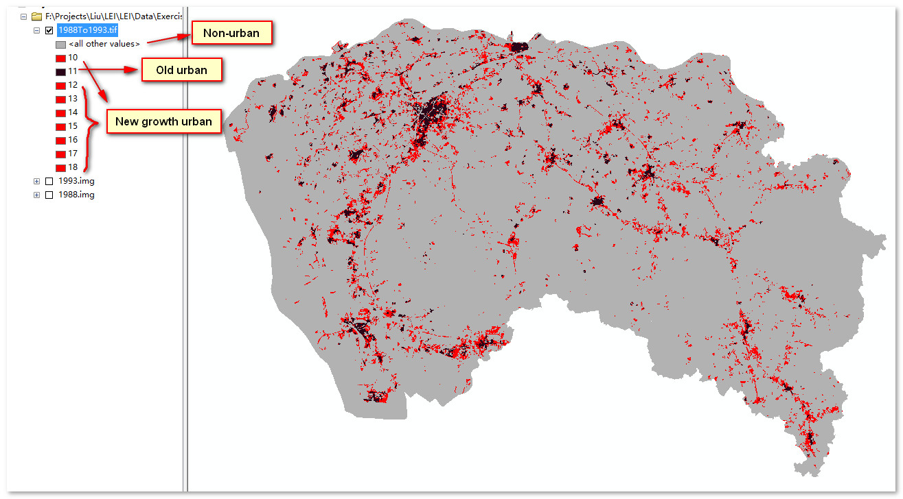
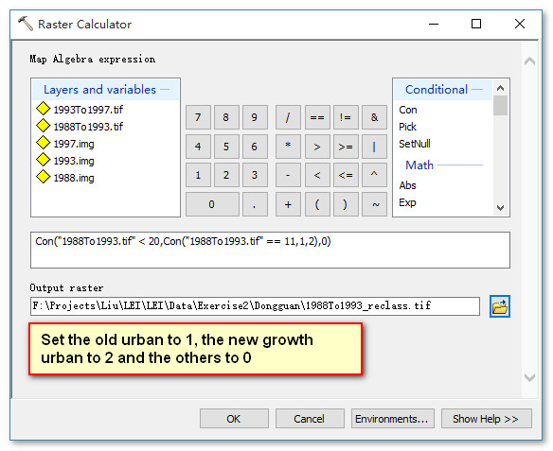
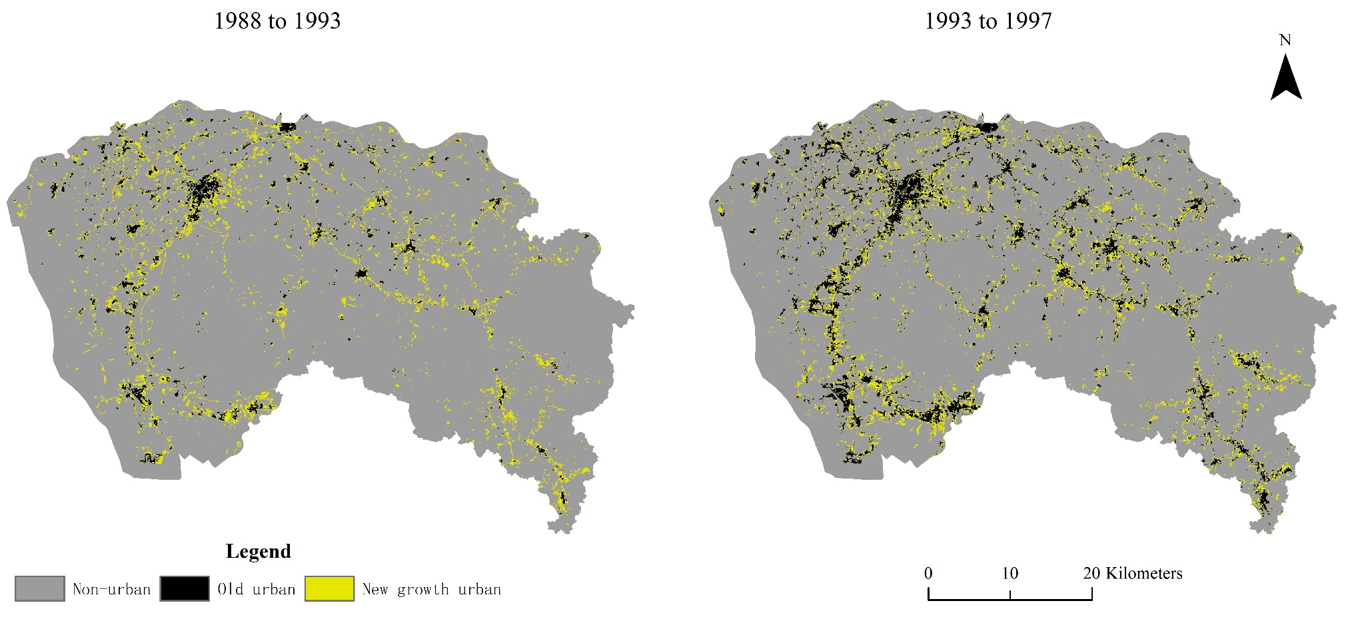
Get the growth area

Slide 16
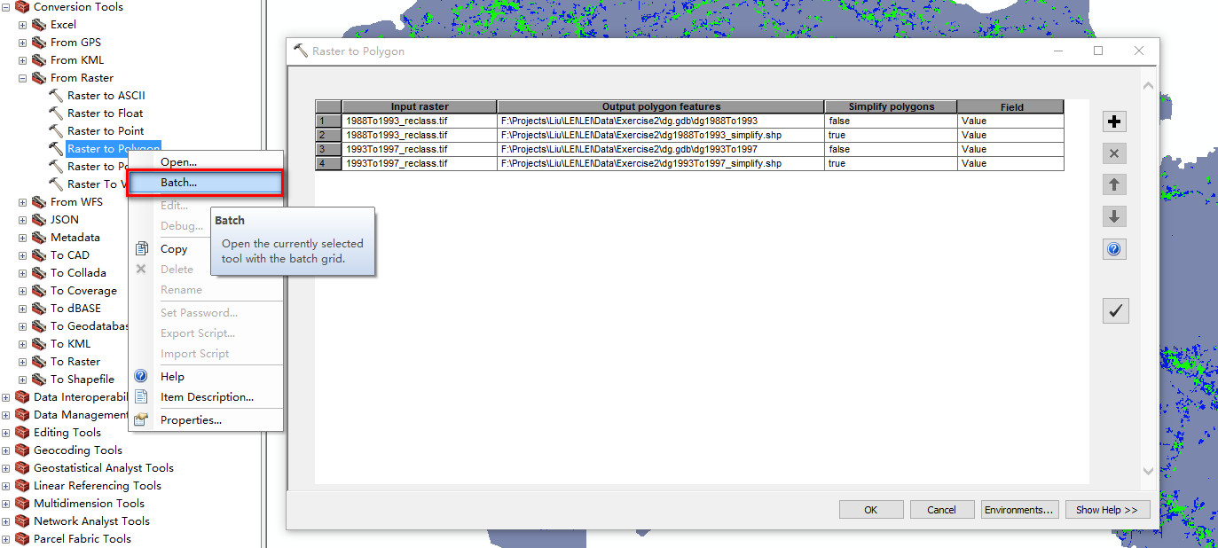
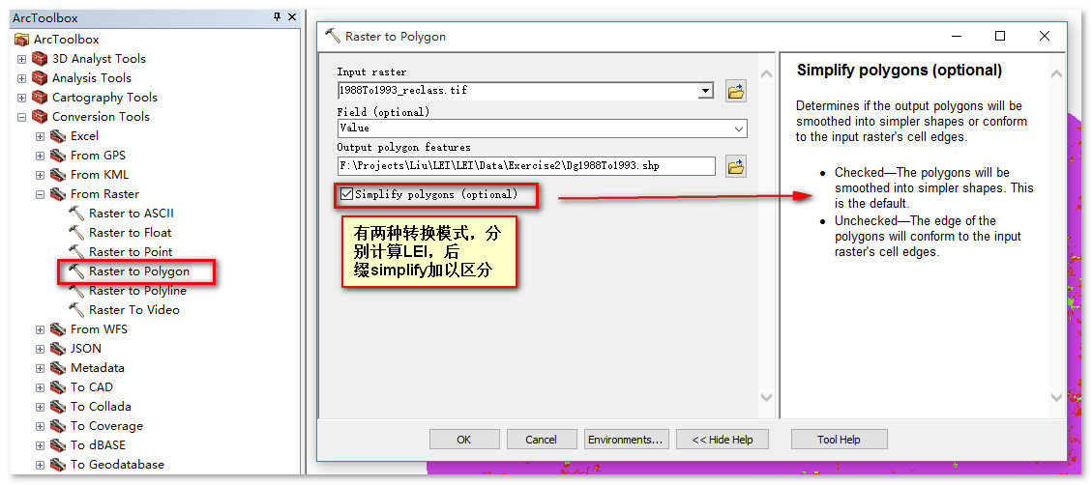
Raster to Polygon

Slide 17
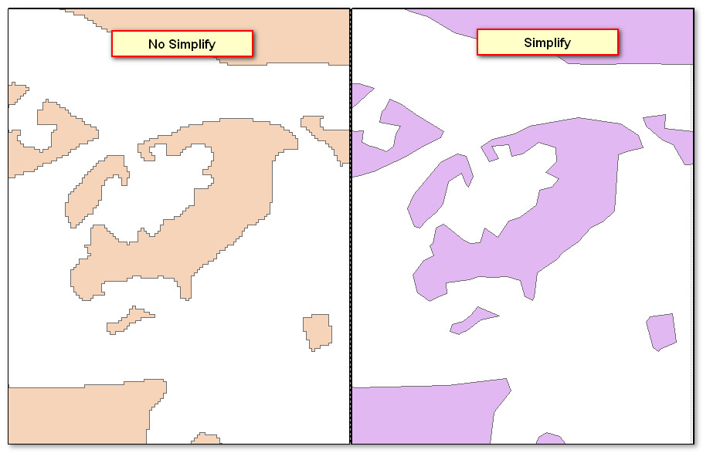
Difference between simplify and no_simplify

Slide 18
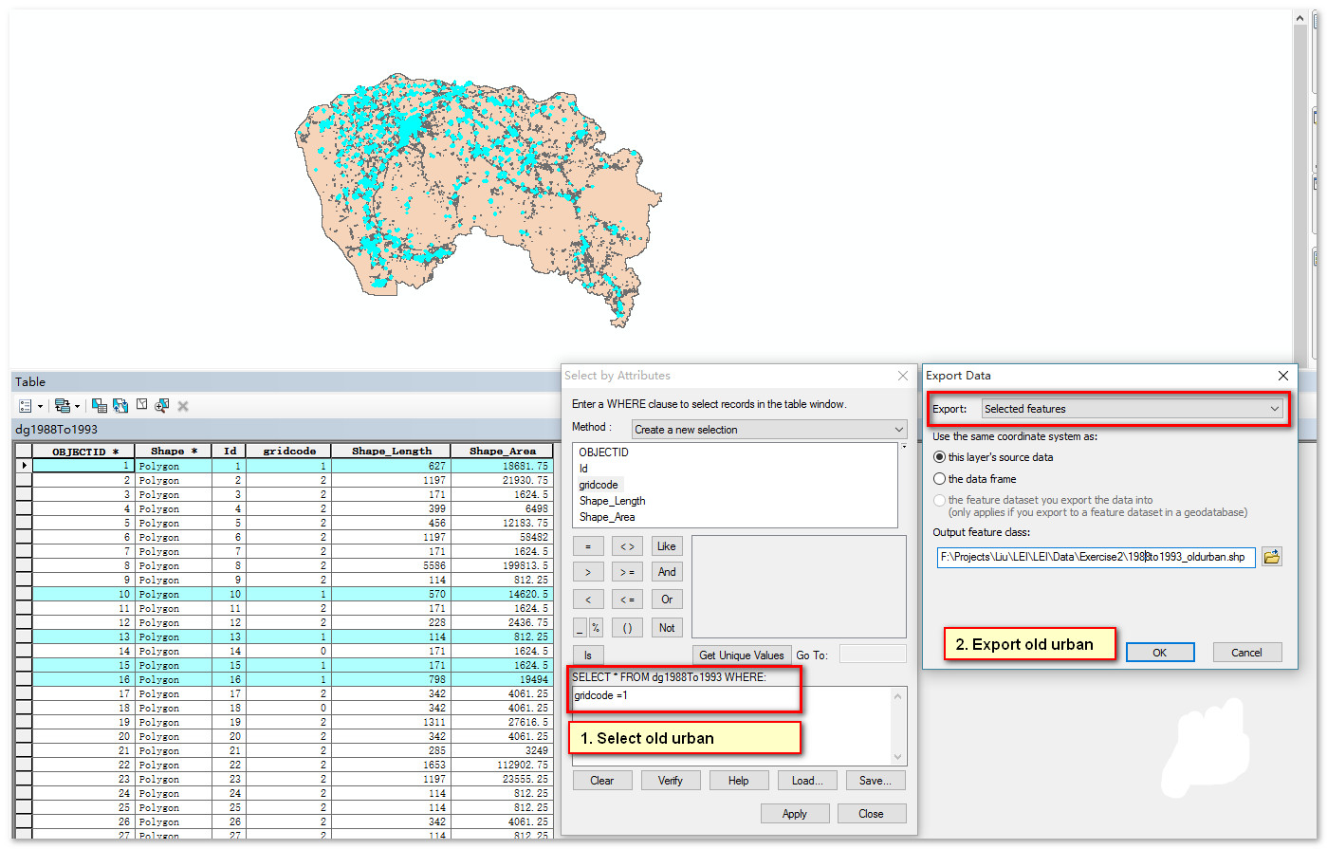
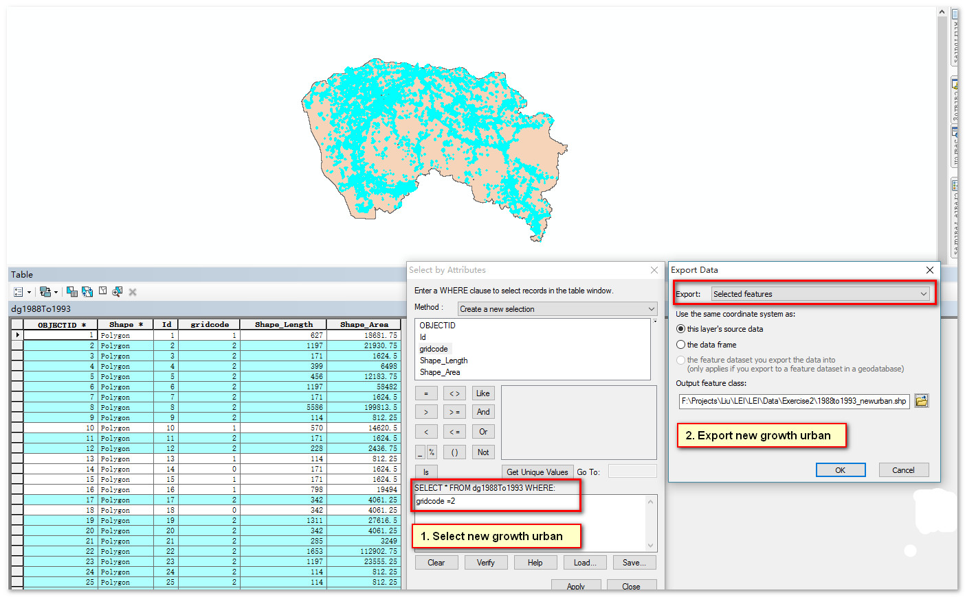
Extract old urban and new growth urban

Slide 19
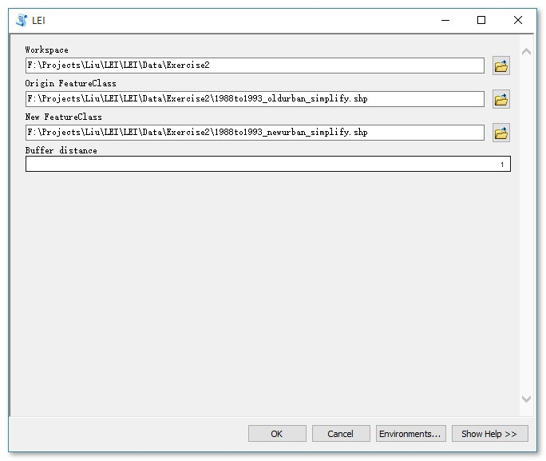
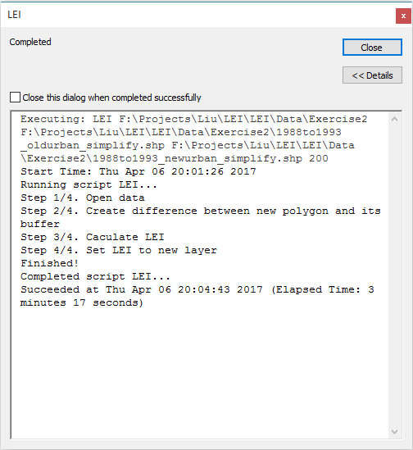
Calculate LEI

Slide 20
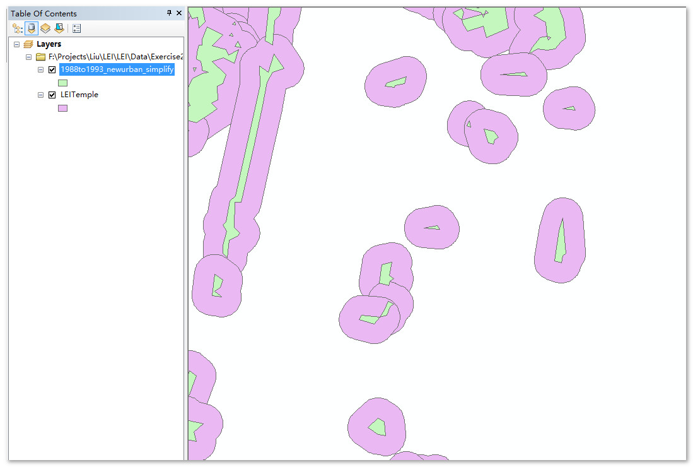
LEITemple Layer——the difference between new polygon and its buffer region

Slide 21
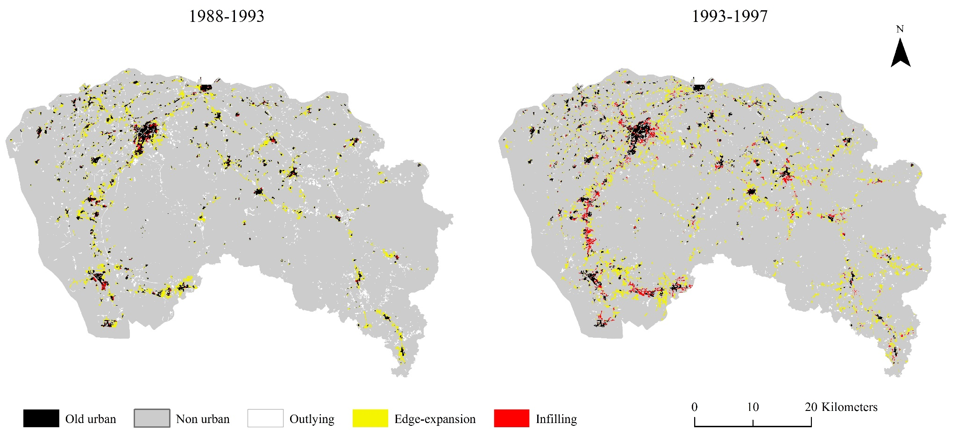
Result of LEI

Slide 22
Thank you !

